Slide 1
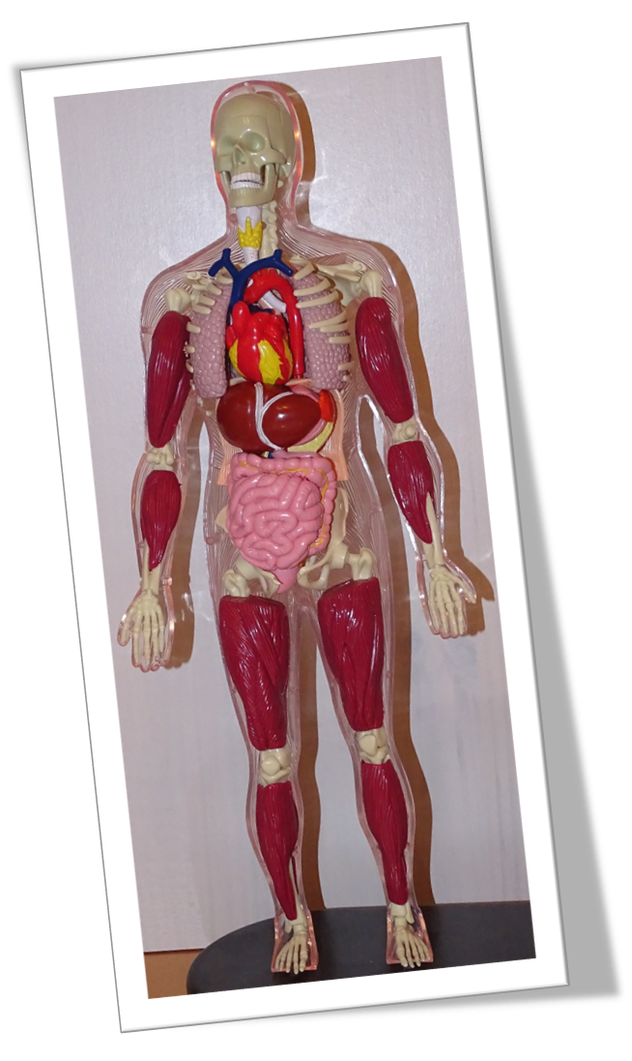
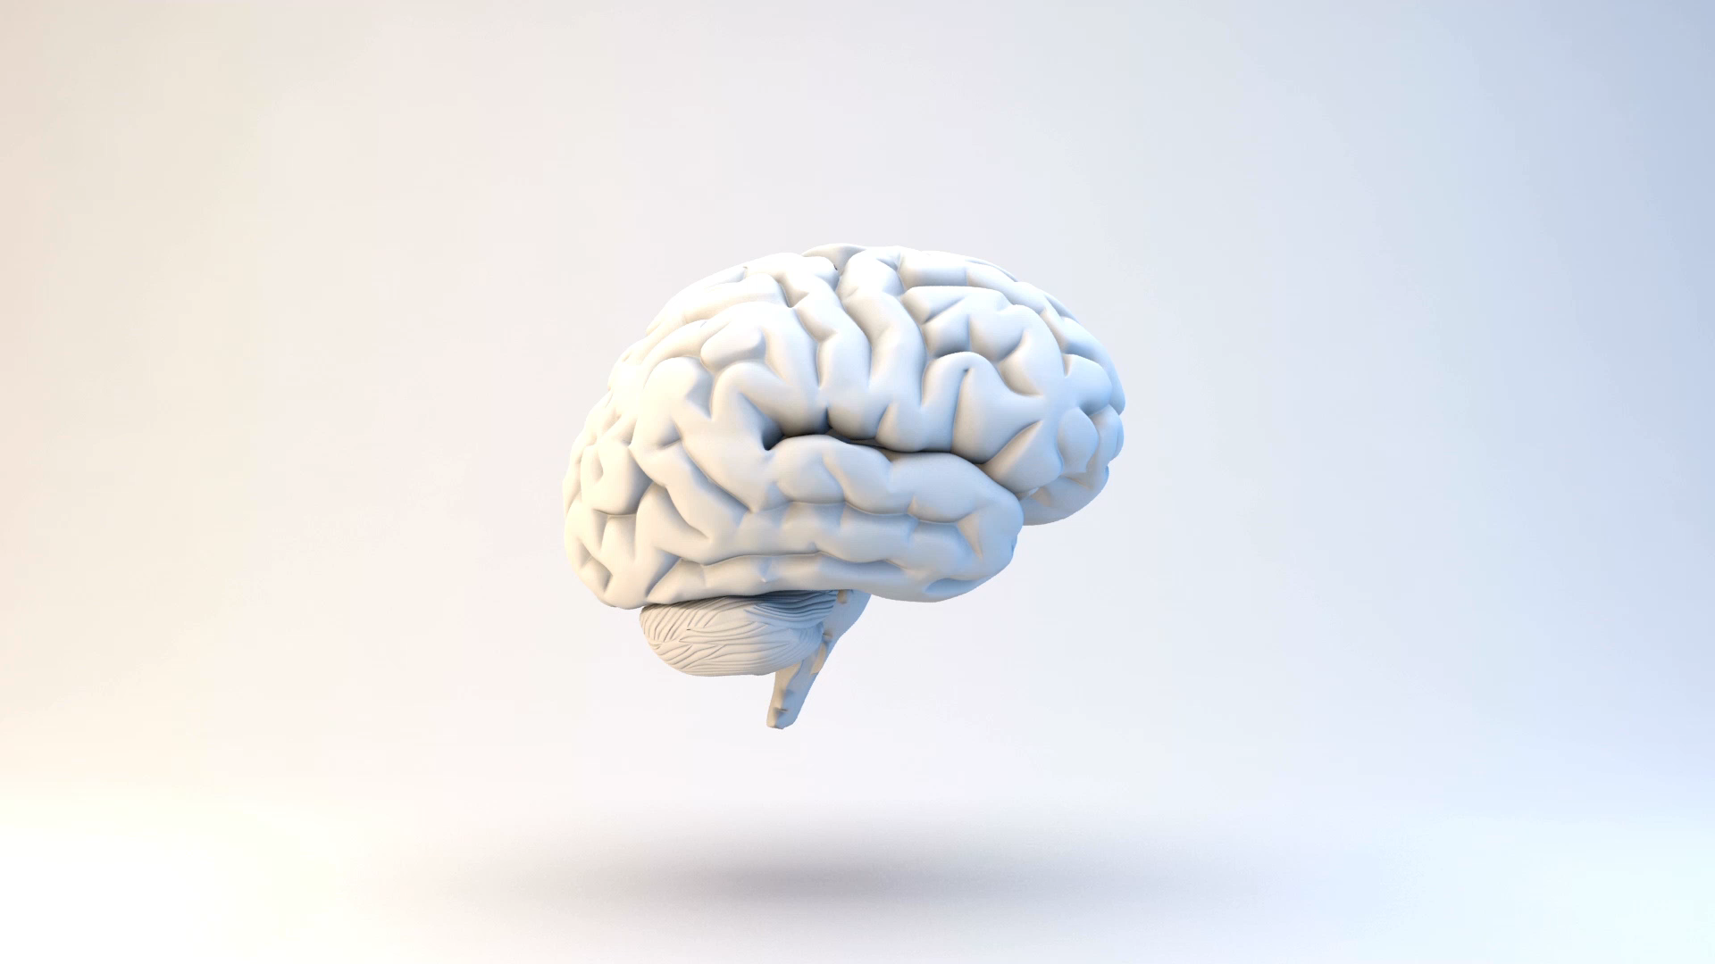
Corpus humanuM

Slide 2
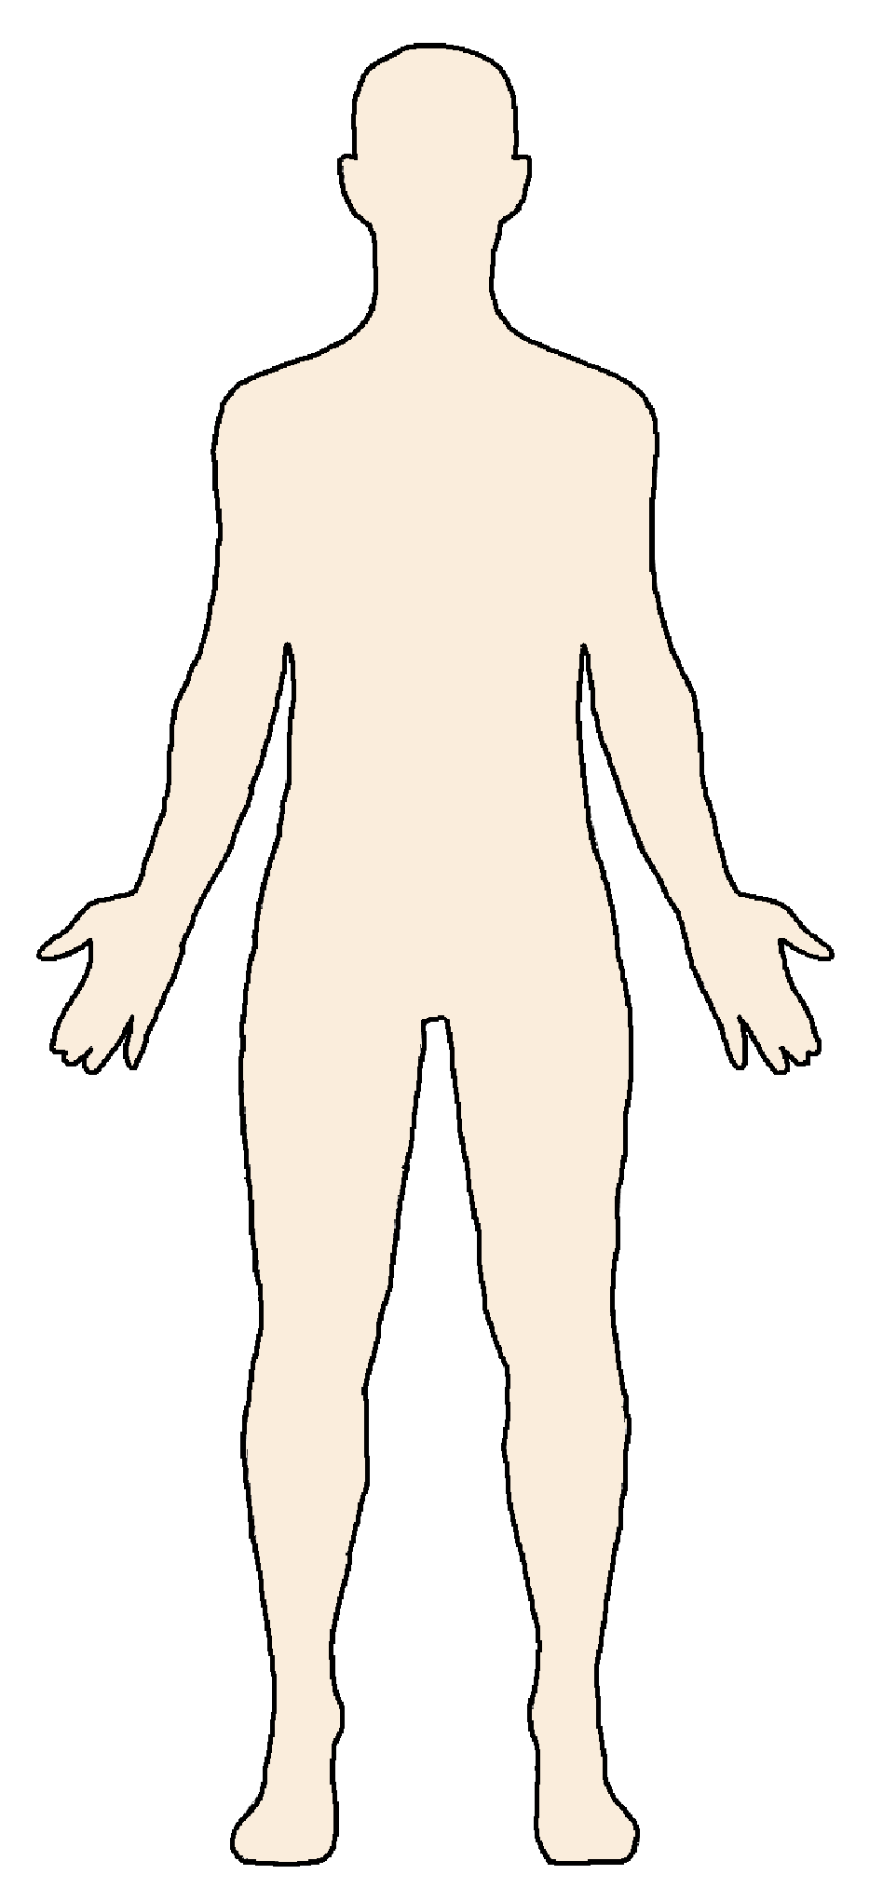
PARTES CORPORIS
caput
collum
brachium
truncus
manus
crus
membra
pes

Slide 3
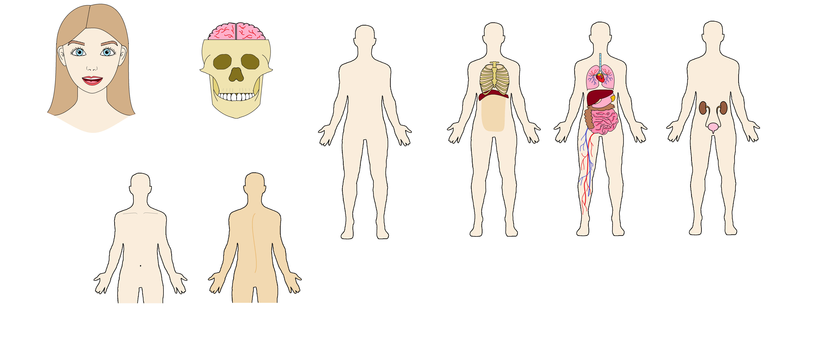
TRUNCUS
pectus
dorsum
venter (abdomen)

Slide 4
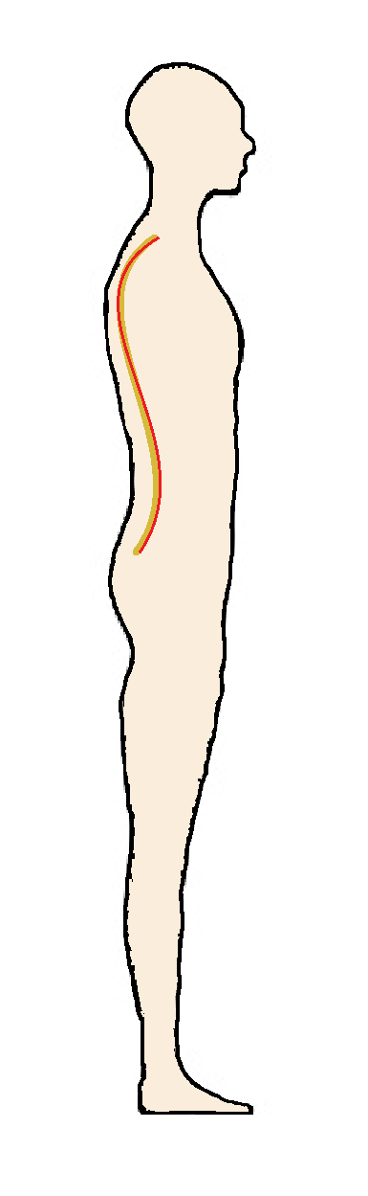
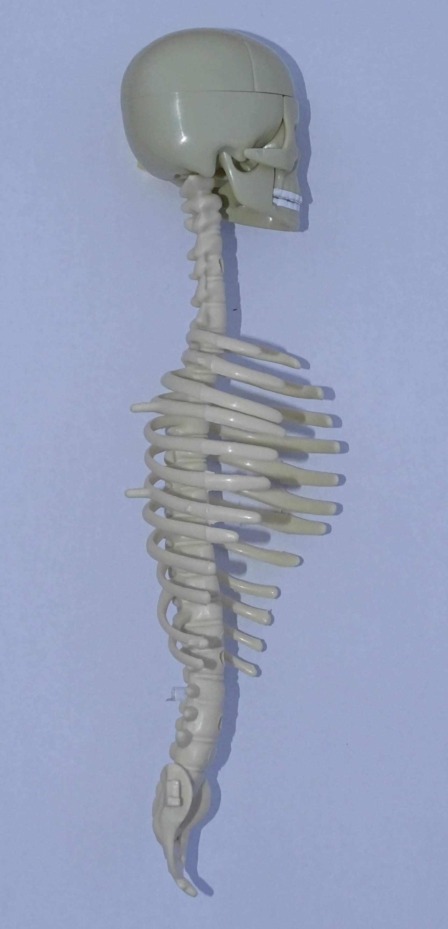
TRUNCUS
medulla spinalis
columna vertebralis

Slide 5
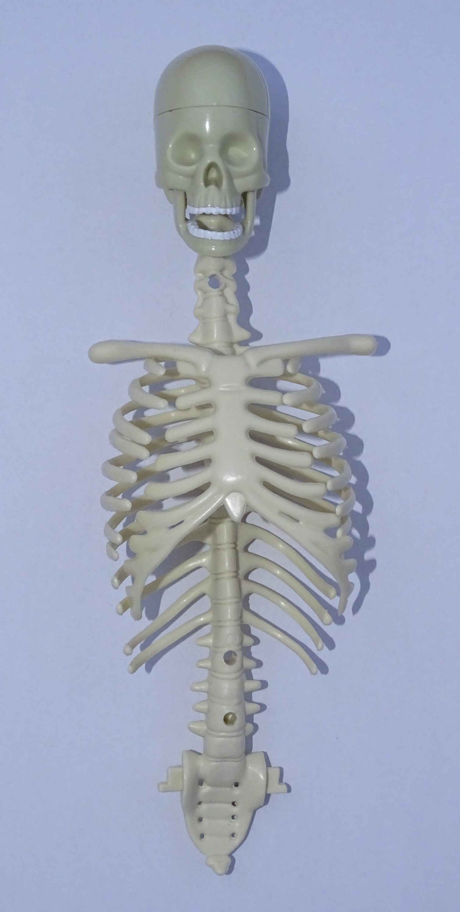
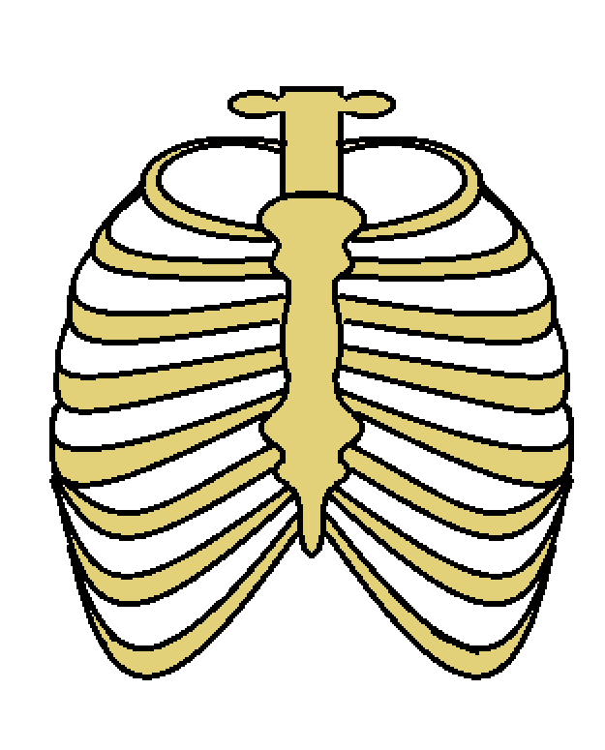
TRUNCUS
cavum thoracale
diaphragma
cavum abdominale
costae
thorax

Slide 6
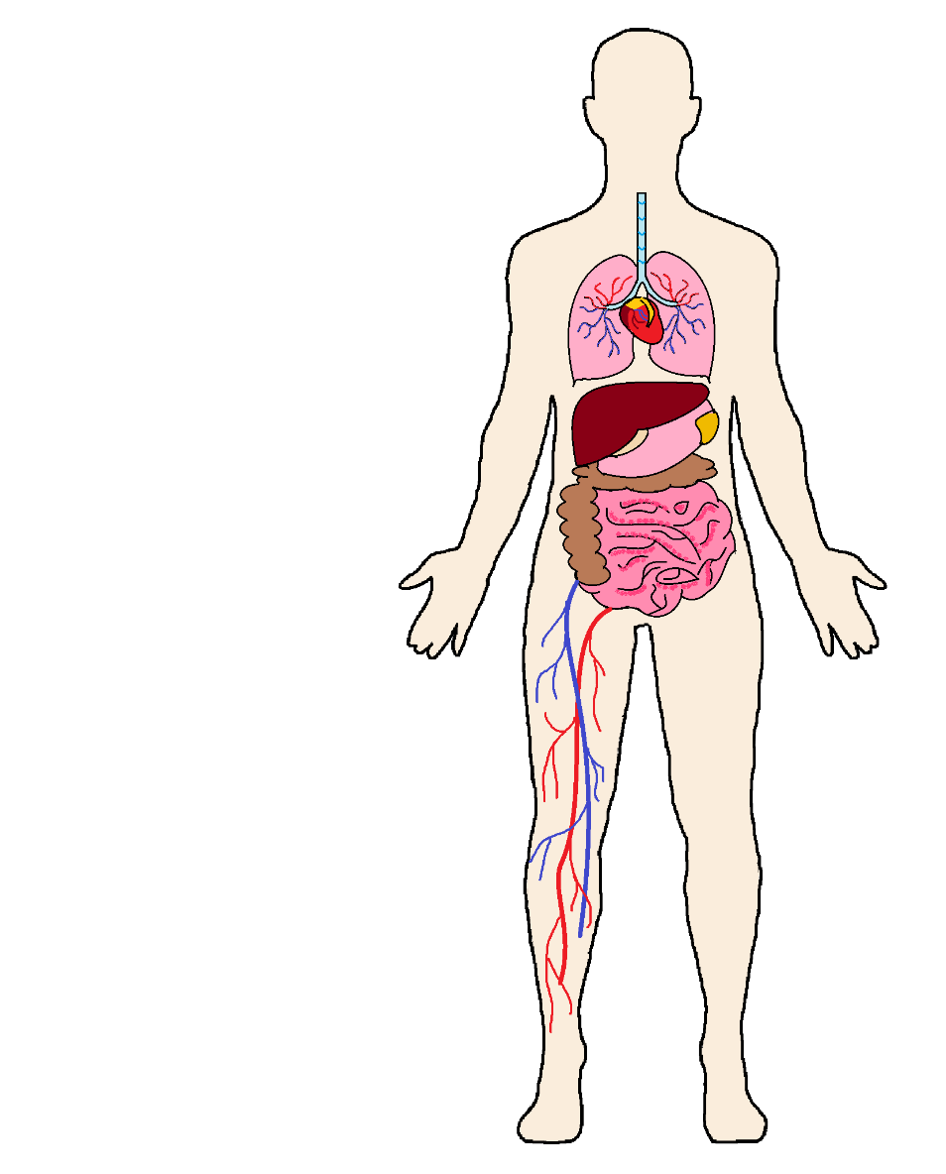
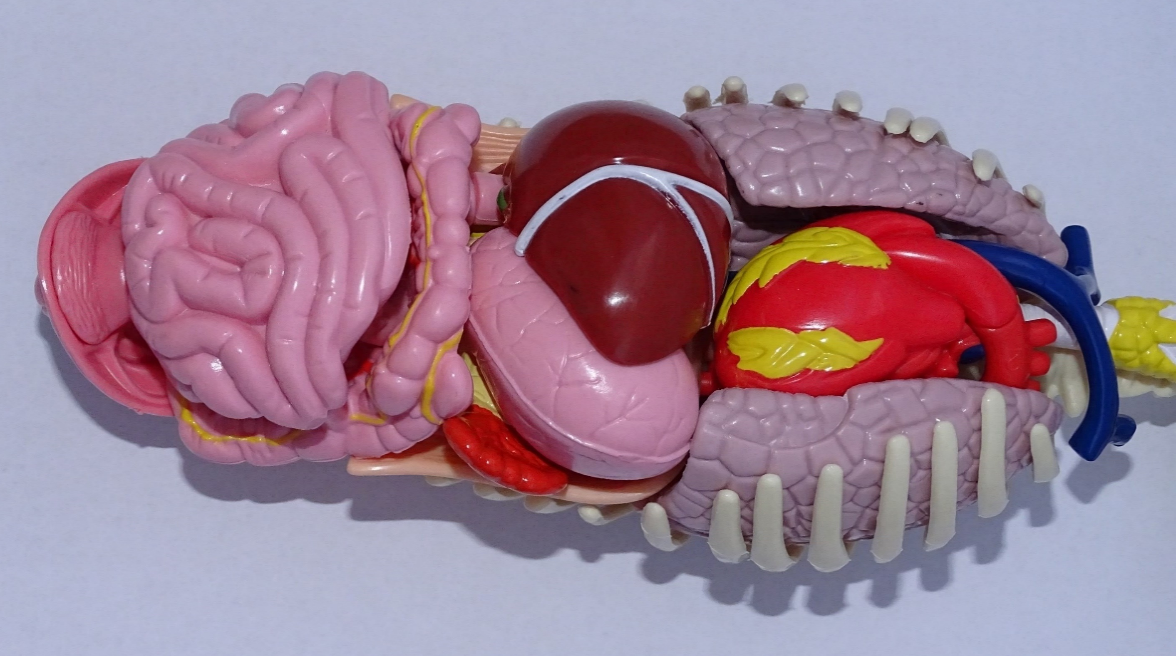
TRUNCUS
pulmones
cor
iecur (hepar)
pancreas
stomachus (ventriculus)
vena
intestinum crassum
intestinum tenue
arteria

Slide 7
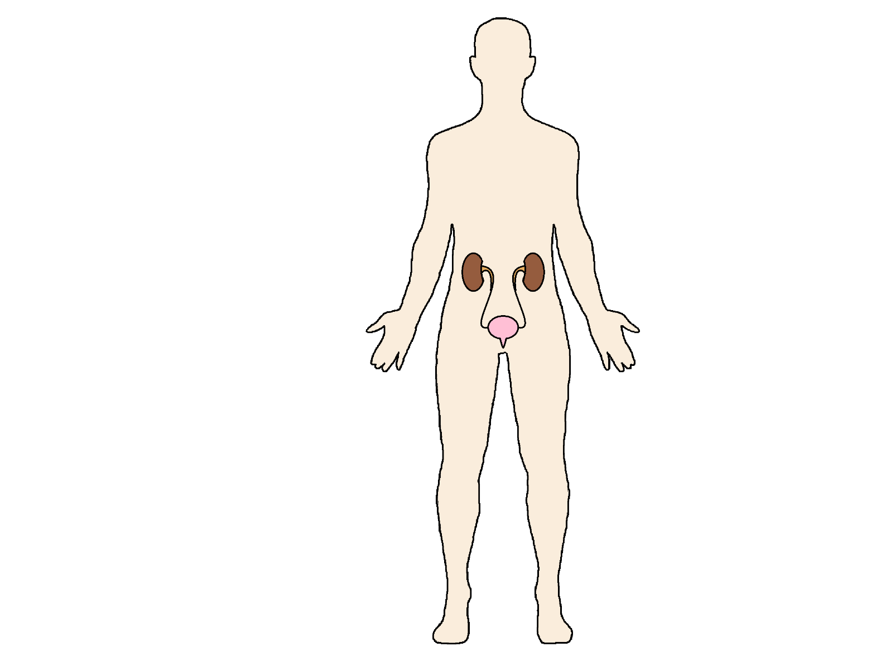
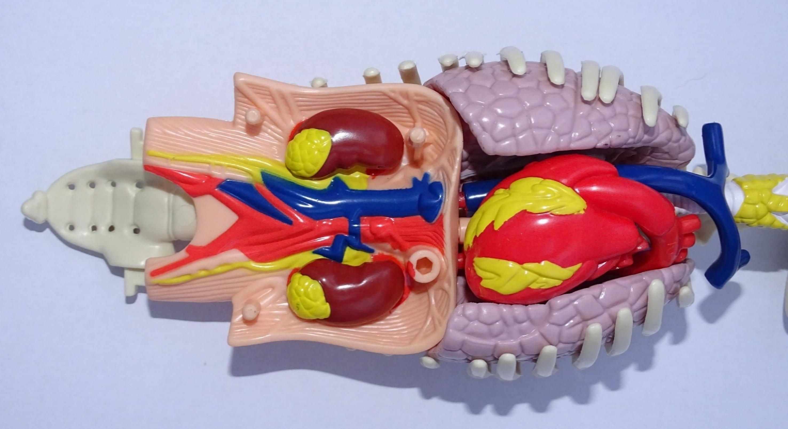
TRUNCUS
ureteres
renes
urethra
vesica urinaria

Slide 8
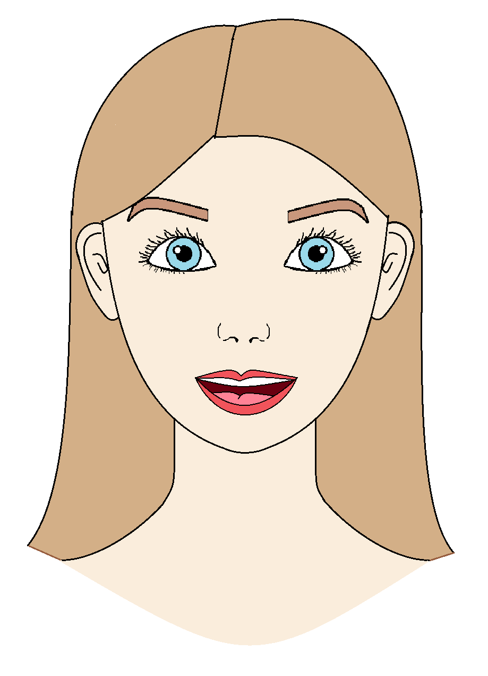
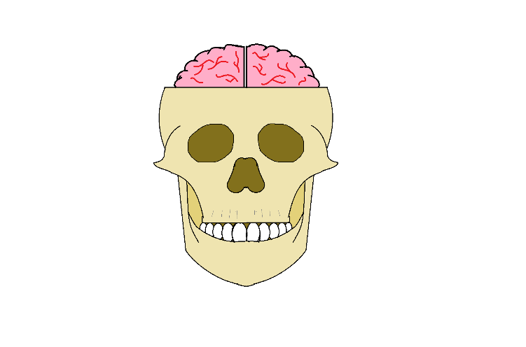
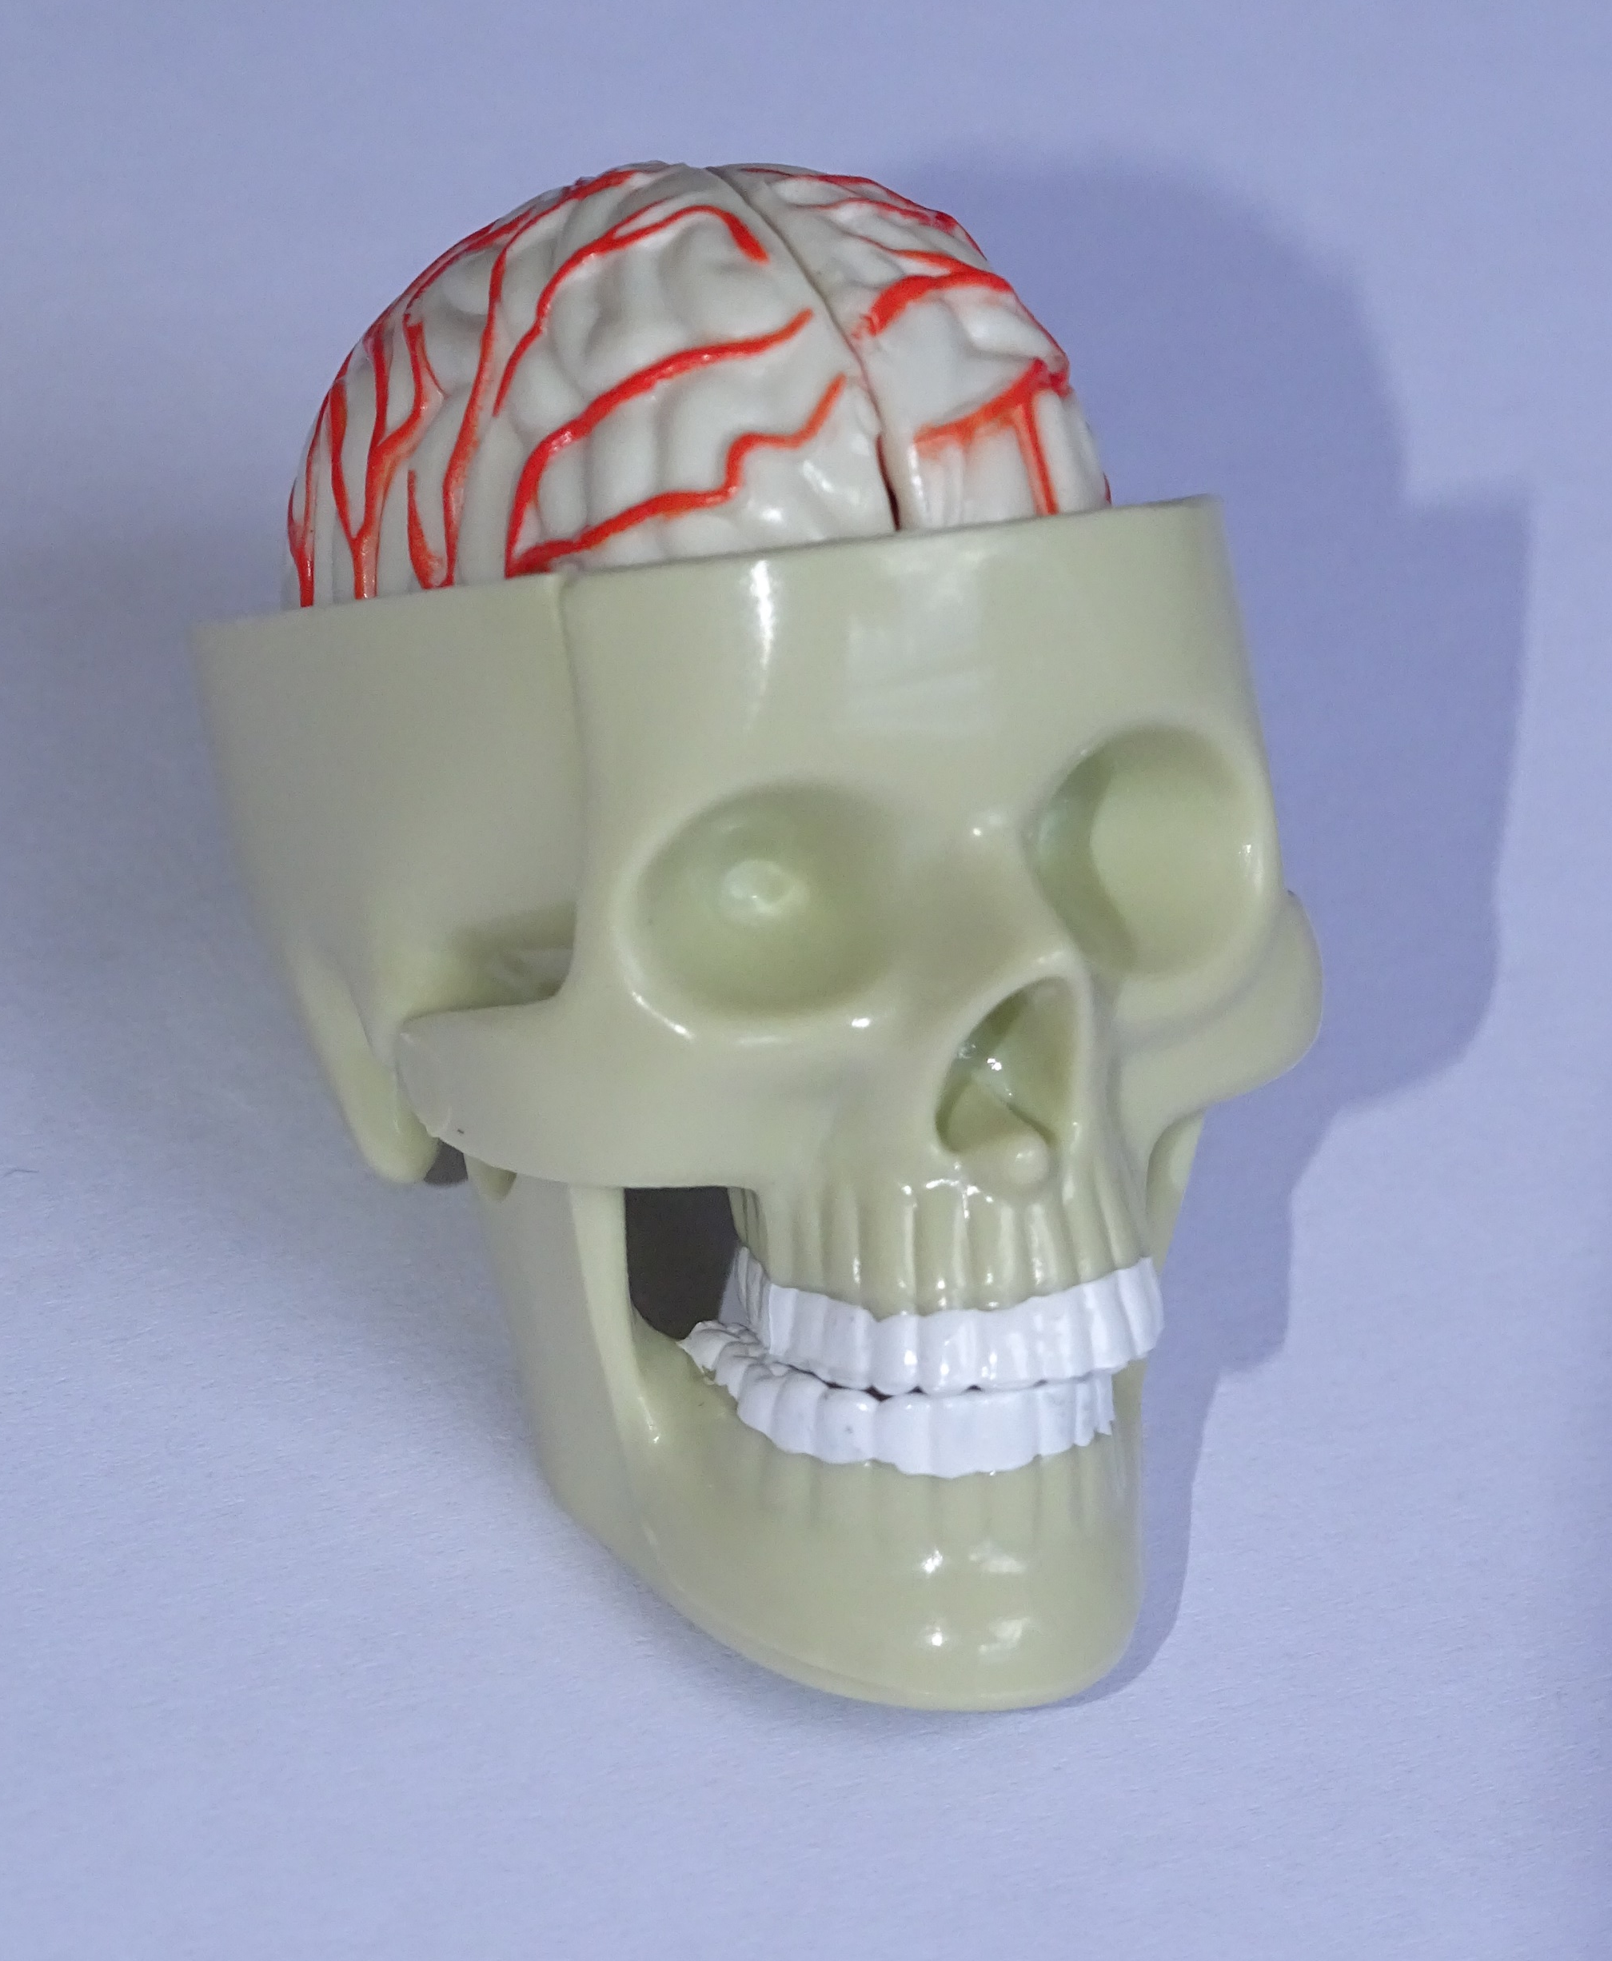
CAPUT
crinis
cerebrum
frons
auris
cranium
bucca
oculus
mentum
nasus
os

Slide 9
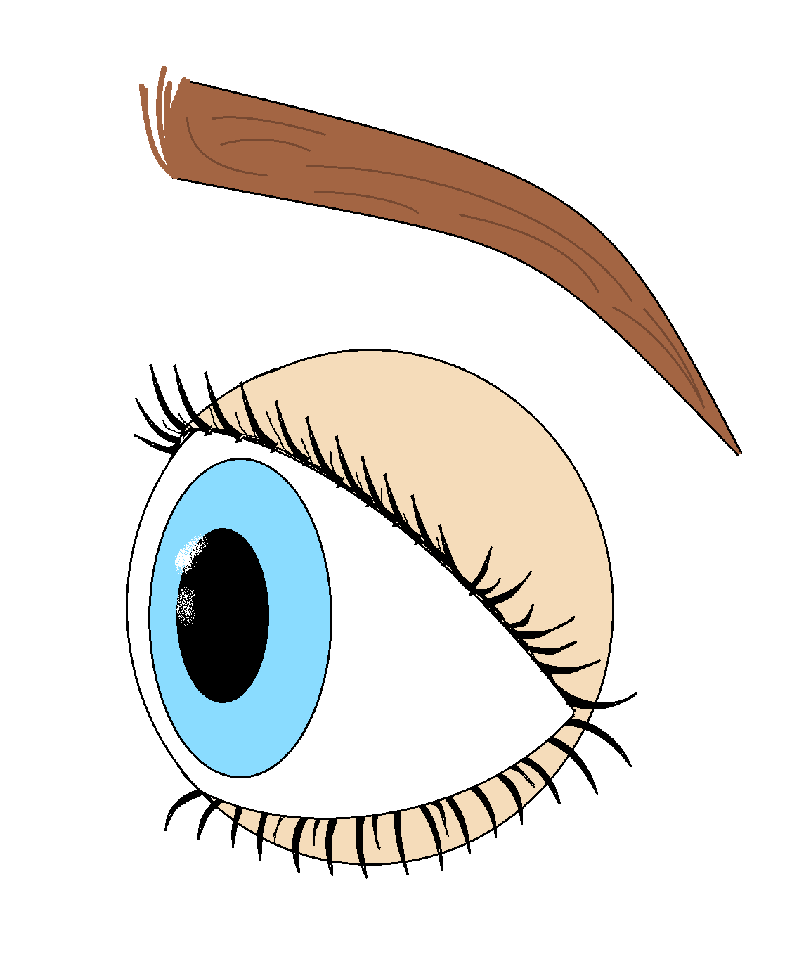
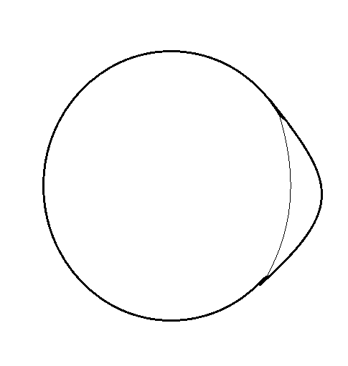
OCULUS
supercilium
bulbus oculi
cornea
cilium
pupilla
palpebra

Slide 10
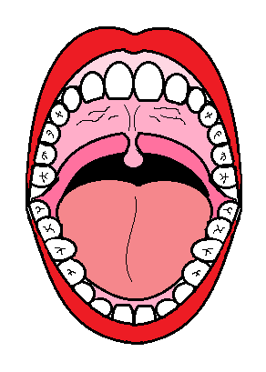
CAPUT : OS
gingiva
dens
palatum durum
palatum molle
lingua
labium

Slide 11
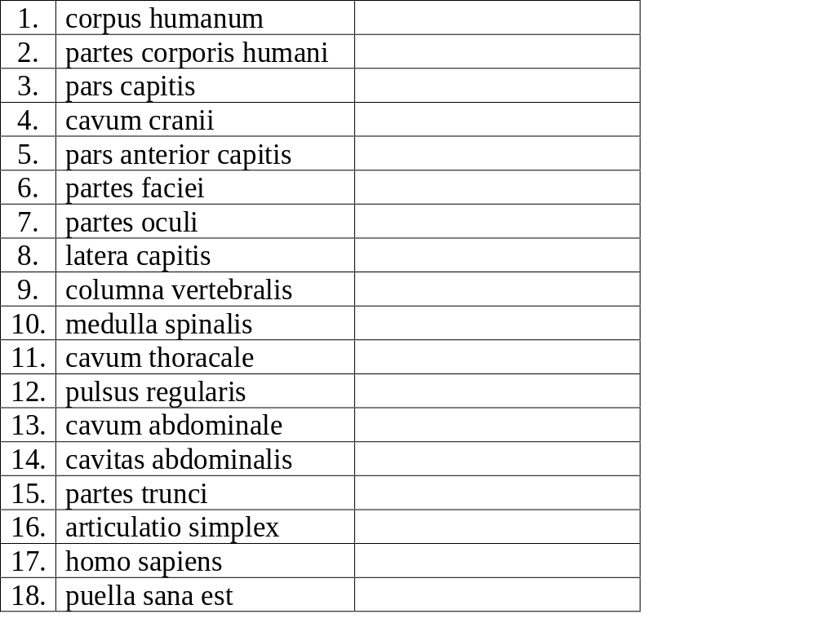
Prevedi na hrvatski zadane sintagme

